Slide 1

RSM & PAXOS
Computer System Engineering, Fall 2019. (IPADS, SJTU)
Consistency across multiple machines
Yubin Xia

Slide 2
Replication Consistency
Optimistic Replication
  Tolerate inconsistency, and fix things up later
  Works well when out-of-sync replicas are acceptable
Pessimistic Replication
  Ensure strong consistency between replicas
  Needed when out-of-sync replicas can cause serious problems

Slide 3
Optimistic Replication

Slide 4
Consistency of Distributed Files
Resolving Inconsistencies
  Suppose we have two computers: laptop and desktop
  File could have been modified on either system
How to figure out which one was updated?
  One approach: use timestamps to figure out which was updated recently
  Many file synchronization tools use this approach

Slide 5
Use of Time in Computer Systems
Time is used by many distributed systems
  E.g., cache expiration (DNS, HTTP), file synchronizers, Kerberos, ..
  Time intervals: how long did some operation take?
  Calendar time: what time/date did some event happen at?
  Ordering of events: in what order did some events happen?

Slide 6
File Reconciliation with Timestamps
Key Problem
  Determine which machine has the newer version of file
Strawman
  Use the file with the highest mtime timestamp
  Works when only one side updates the file per reconciliation
Notes:
H1: a=1 ->H2
H2: R(a) a=3 ->H1
---
H1: a=1 ->H2
H2: R(a) a=2 ->H1

Slide 7
File Reconciliation with Timestamps
Better plan
  Track last reconcile time on each machine
  Send file if changed since then, and update last reconcile time
  When receiving, check if local file also changed since last reconcile
New Outcome
  Timestamps on two versions of a file could be concurrent
  Key issue with optimistic concurrency control: optimism was unwarranted
  Generally, try various heuristics to merge changes (text diff/merge, etc)
  Worst case, ask the user (e.g., if edited same line of code in C file)
Notes:
H1: a=1 ->H2
H2: R(a) a=2 ->H1
H3: R(a) a=3 ->H1

Slide 8
File Reconciliation with Timestamps
Goal: No Lost Updates
  V2 should overwrite V1 if V2 contains all updates that V1 contained
  Simple timestamps can't help us determine this

Slide 9
Time Measuring
Measuring time intervals
  Computer has a reasonably-fixed-frequency oscillator (e.g., quartz crystal)
  Represent time interval as a count of oscillator's cycles
    time period = count / frequency
    e.g., with a 1MHz oscillator, 1000 cycles means 1msec

Slide 10
Time Measuring
Keeping track of calendar time
  Typically, calendar time is represented using a counter from some fixed epoch
  For example, Unix time is #seconds since midnight UTC at start of Jan 1, 1970
  Can convert this counter value into human-readable date/time, and vice-versa
    Conversion requires two more inputs: time zone, data on leap seconds
Notes:
[ demo: date +%s shows number of seconds after the Unix epoch ]

Slide 11
Time Measuring
What happens when turn off the computer?
  "Real-Time Clock" (RTC) chip remains powered, with battery / capacitor
  Stores current calendar time, has an oscillator that increments periodically
Maintaining accurate time
  Accuracy: for calendar time, need to set the clock correctly at some point
  Precision: need to know oscillator frequency (drift due to age, temp, etc.)

Slide 12
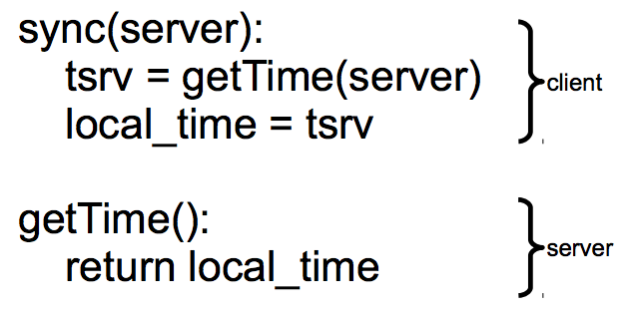
Clock Synchronizing
Synchronizing a clock over the internet: NTP
  Query server's time, adjust local time accordingly
Notes:
ntpdate -d 203.17.251.1
% ntpdc -n 203.17.251.1
ntpdc> peers
ntpdate -d ntp.sjtu.edu.cn

Slide 13
Clock Synchronizing
Need to take into account network latency
  Simple estimate: RTT/2
  When does this fail to work well?
    Asymmetric routes, with different latency in each direction
    Queuing delay, unlikely to be symmetric even for symmetric routes
    Busy server might take a long time to process client's request
  Can use repeated queries to average out (or estimate variance) for second two

Slide 14
Estimating Network Latency
sync(server):
t_begin = local_time
tsrv = getTime(server)
t_end = local_time
delay = (t_end-t_begin) / 2
offset = (t_end-delay) - tsrv
local_time = local_time - offset
Notes:
ntpdate -d 203.17.251.1
% ntpdc -n 203.17.251.1
ntpdc> peers

Slide 15
Clock Synchronizing
What if a computer's clock is too fast
  E.g., 5 seconds ahead
  Naive plan: reset it to the correct time
    Can break time intervals being measured (e.g., negative interval)
    Can break ordering (e.g., older files were created in the future)
  "make" is particularly prone to these errors
Principle: time never goes backwards
  Idea: temporarily slow down or speed up the clock
  Typically cannot adjust oscillator (fixed hardware)
  Adjust oscillator frequency estimate, so counter advances faster / slower

Slide 16
Slew Time
sync(server):
t_begin = local_time
tsrv = getTime(server)
t_end = local_time
delay = (t_end-t_begin) / 2
offset = (t_end-delay) - tsrv
freq = base + ε * sign(offset)
sleep(freq * abs(offset) / ε)
freq = base
timer_intr(): # on every oscillator tick
local_time = local_time + 1/freq
temporarily speed up / slow down local clock

Slide 17
Improving Time Precision
If only adjust our time once
  An inaccurate clock will lose accuracy
  Need to also improve precision, so we don't need to slew as often
Assumption: poor precision caused by poor estimate of oscillator frequency
  Can measure difference between local and remote clock "speeds" over time
  Adjust local frequency estimate based on that information
  In practice, may want more stable feedback loop (PLL): look at control theory

Slide 18
Vector Timestamps
Idea: vector timestamps
  Store a vector of timestamps from each machine
  Entry in vector keeps track of the last mtime
  V1 is newer than V2 if all of V1's timestamps are >= V2's
  V1 is older than V2 if all of V1's timestamps are <= V2's
  Otherwise, V1 and V2 were modified concurrently, so conflict
  If two vectors are concurrent, one computer modified file without seeing the latest version from another computer
  If vectors are ordered, everything is OK as before

Slide 19
Vector Timestamps
Cool property of version vectors:
  A node's timestamps are only compared to other timestamps from same node
  Time synchronization not necessary for reconciliation w/ vector timestamps
  Can use a monotonic counter on each machine
Does calendar time still matter?
  More compact than vector timestamps
  Can help synchronize two systems that don't share vector timestamps

Slide 20
Pessimistic replication
RSM & Paxos

Slide 21
Pessimistic Replication
Some applications may prefer not to tolerate inconsistency
  E.g., a replicated lock server, or replicated coordinator for 2PC
  E.g., Better not give out the same lock twice
  E.g., Better have a consistent decision about whether transaction commits
Trade-off: stronger consistency with pessimistic replication means:
  Lower availability than what you might get with optimistic replication

Slide 22
Single-copy Consistency
Problem of optimistic way: replicas get out of sync
  One replica writes data, another doesn't see the changes
  This behavior was impossible with a single server
Ideal goal: single-copy consistency
  Property of the externally-visible behavior of a replicated system
  Operations appear to execute as if there's only a single copy of the data
    Internally, there may be failures or disagreement, which we have to mask
  Similar to how we defined serializability goal ("as if executed serially")

Slide 23
Replicating a Server
Strawman
  Clients send requests to both servers
  Tolerating faults: if one server is down, clients send to the other
Tricky case: what if there's a network partition?
  Each client thinks the other server is dead, keeps using its server
  Bad situation: not single-copy consistency!

Slide 24
Handling Network Partitions
Issue: Clients may disagree about what servers are up
  Hard to solve with 2 servers, but possible with 3 servers
Idea: require a majority servers to perform operation
  In case of 3 servers, 2 form a majority
  If client can contact 2 servers, it can perform operation (otherwise, wait)
  Thus, can handle any 1 server failure

Slide 25
Quorum
Define separate read &write quorums: Q_{r} & Q_{w}
  Q_{r} + Q_{w} > N_{replicas} (Why?)
    Confirm a write after writing to at least Q_{w} of replicas
    Read at least Q_{r} agree on the data or witness value
Example
  In favor of reading: N_{replicas} = 5, Q_{w} = 4, Q_{r} = 2
  In favor or updating: N_{replicas} = 5, Q_{w} = 2, Q_{r} = 4
  Enhance availability by Q_{w} = N_{replicas} & Q_{r} = 1

Slide 26
Quorum
Provide no before-or-after or all-or-nothing
  If reading & writing requests come from a site
    Easy…
  If reading from multiple sites, writing from one site
    Maintain a version number at that site
  If writing from multiple sites
    Protocol providing a distributed sequencer
Another complicating consideration
  Performance maximization

Slide 27
Simple Implementation: Replicated Logs
Replicated Logs
  Log client operations, including both R/W, and numbered
Key issue: agreeing on the order of operations
  Coordinator handles one client operation at a time
  Coordinator chooses an order for all operations (assigns log sequence number)
  Coordinator issues the operation to each replica
  When is it OK to reply to client?
    Must wait for majority of replicas to reply
    Otherwise, if a minority crashes, remaining servers may continue without op

Slide 28
Handling Network Partitions
Why does the majority rule work?
  Any two majority sets of servers overlap
  Suppose two clients issue operations to a majority of servers
  Must have overlapped in at least one server, will help ensure single-copy

Slide 29
Handling Network Partitions
Problem: replicas can become inconsistent
  Issue: clients' requests to different servers can arrive in different order
  How do we ensure the servers remain consistent?

Slide 30
RSM

Slide 31
RSM: Replicated State Machines
A general approach to making consistent replicas of a server:
  Start with the same initial state on each server
  Provide each replica with the same input operations, in same order
  Ensure all operations are deterministic
    E.g., no randomness, no reading of current time, etc.
These rules ensure each server will end up in the same final state

Slide 32
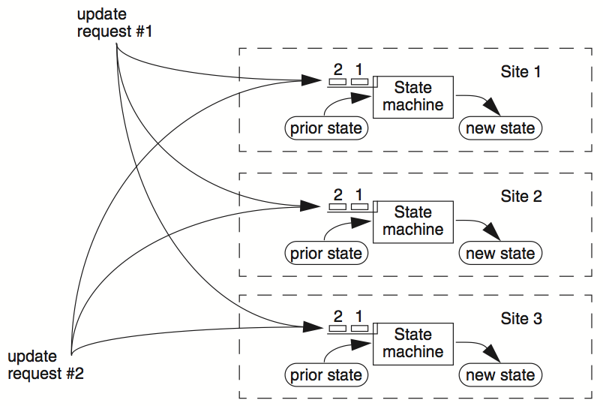

Slide 33
C₁
S₁
write₁(x)
C₂
S₂
write₂(x)
(replica of S₁)

Slide 34
C₁
S₁
write₁(x)
write₂(x)
C₂
S₂
write₁(x)
write₂(x)
(replica of S₁)
problem: How to ensure the order of operations?

Slide 35
RSM: Replicated State Machines
RSMs provide single-copy consistency
  Operations complete as if there is a single copy of the data
  Though internally there are replicas
RSMs use a primary-backup mechanism for replication
  Using view server ensures that only one replica acts as the primary
  It can also recruit new backups after servers fail

Slide 36
Primary/Backup Model
Primary does important stuff
  Ensures that it sends all updates to the backup before ACKing the coordinator
  Chooses an ordering for all operations, so that the primary and backup agree
  Decides all non-deterministic values (e.g., random(), time())

Slide 37
What if Primary Fails?
Idea 1: Coordinator knows about both primary and backup, and decides which to use
  Won't work: split brain syndrome
  Multiple coordinators come to independent, and different, conclusions about who is primary when there are network partitions
Idea 2: Have human decide when to switch from primary to backup
  Not unreasonable for small web services

Slide 38
Primary/Backup Model
(primary)
S₁
C
S₂
if primary fails, C knows about S₂, and switches
(backup)
attempt: coordinators communicate with primary
servers, who communicate with backup servers

Slide 39
Primary/Backup Model
(primary)
X
S₁
C
S₂
if primary fails, C knows about S₂, and switches
(backup)
attempt: coordinators communicate with primary
servers, who communicate with backup servers

Slide 40
Primary/Backup Model
X
S₁
C
S₂
if primary fails, C knows about S₂, and switches
(primary)
attempt: coordinators communicate with primary
servers, who communicate with backup servers

Slide 41
Multiple Coordinators + the Network = Problems
(primary)
C₁
S₁
network partition
C₂
S₂
(backup)
attempt: coordinators communicate with primary
servers, who communicate with backup servers

Slide 42
Multiple Coordinators + the Network = Problems
(primary)
C₁
S₁
network partition
C₂
S₂
(backup, but primary for C₂)
C₁ and C₂ are using different primaries;
S₁ and S₂ are no longer consistent

Slide 43
View Server
1. The view server keeps a table that maintains a sequence of "view"
  Each view contains the view number, the primary server, and the backup server
2. The view server alerts each server as to whether it's the primary or the backup
3. Upon receiving any updates, the primary will receive an ACK from the backup before responding to the view server (just as before)
4. Coordinators make requests to the view server asking who is primary
  Coordinators then contact the primary

Slide 44

View Server
(primary)
S₁
S₁
primary
C
primary?
VS
S₁
backup
1: S₁, S₂
S₂
(backup)
Use a view server, which determines which replica is the primary

Slide 45
View Server
To discover failures
  Replicas ping to the view server
  If view server misses N pings in a row, it deems a server to be dead
Basic failure (actual worker crash):
  1. Primary fails; pings cease
  2. View server lets S2 know it's primary, and it handles any client requests
    Before S2 knowing it's the primary, it will simply reject requests that come directly from coordinators
  3. View server will eventually recruit a new idle server to act as backup

Slide 46
Failure of Primary
(dead)
X
S₁
C
VS
lack of pings indicates to VS that S₁ is down
1: S₁, S₂
S₂
(backup)
Use a view server, which determines which replica is the primary

Slide 47
Failure of Primary
(dead)
X
S₁
C
primary?
VS
S₂
primary
1: S₁, S₂
2: S₂, --
S₂
S₂
(primary)
before S₂ knows it's primary, it will reject any requests from clients

Slide 48
Facing Network Partitions
A few rules
  1. Primary must wait for backup to accept each request
  2. Non-primary must reject direct coordinator requests
    That's what happened in the earlier failure, in the interim between the failure and S2 hearing that it was primary
  3. Primary must reject forwarded requests
    I.e., it won't accept an update from the backup
  4. Primary in view i must have been primary or backup in view i-1

Slide 49
Network Partitions
Network Partition between VS and S₁
(primary)
lack of pings indicates to VS that S₁ is down
S₁
S₁
C
VS
1: S₁, S₂
S₂
(backup)

Slide 50
Network Partitions
Network Partition between VS and S₁
(primary)
S₁
S₁
VS makes S₂ primary
C
VS
primary
1: S₁, S₂
2: S₂, --
S₂
rejected by S₂
(backup)
it's okay! S2 will act as backup
(accept updates from S1, reject coordinator requests)
problem: what happens before S₂ knows it's the primary?

Slide 51
Network Partitions
Network Partition between VS and S₁
rejected by S₁
(Cannot get ACK from S₂)
(primary)
S₁
S₁
C
VS
1: S₁, S₂
2: S₂, --
S₂
(primary)
also okay! S1 won't be able to act as primary
(can't accept client requests because it won't get ACKs from S2)
problem: what happens after S2 knows it's the primary,
but S1 also thinks it is?

Slide 52
Consider S₁ being Partitioned from the VS
Before S2 hears about View #2:
  S1 can process operations from coordinators, S2 will accept forwarded requests
  S2 will reject operations from coordinators who have heard about view #2
After S2 hears about View #2:
  If S1 receives coordinator requests, it will forward. S2 will reject (not ACK), so S1 can no longer act as primary.
  S1 will send error to coordinator, coordinator will ask VS for new view, learn about view #2, and coordinator will re-send to S2
The commit point of switch-over: when S2 hears about View #2

Slide 53
(primary)
S₁
S₁
C
X
VS
1: S₁, S₂
S₂
(backup)
problem: what if view server fails?

Slide 54
Paxos
Distributed consensus mechanism

Slide 55
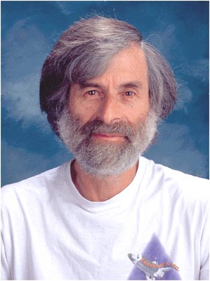
Leslie Lamport
http://ipads.se.sjtu.edu.cn/courses/cse-g/2012f/Schedule_files/paxos-simple.pdf

Slide 56
Paxos
Paxos' properties: correct + fault-tolerance
    No guaranteed termination
Goal: have all acceptors agree to a value V associated with a proposal
Proposer
Proposer
Proposer
Acceptor
Client
Network
Acceptor
Acceptor
leader
Learner
Learner
quorum
Learner
Paxos: one machine may serve several roles

Slide 57
Paxos Players
Client
makes a request
Proposer
Get a request and run the protocol
Leader = elected Coordinator
Acceptor
Remember the state of the protocol
Quorum = any majority of Acceptors
Learner
When agreement has been reached,
a Learner executes the request and/or sends a response back to the Client

Slide 58
General Approach
One proposer decides to be the leader
Leader proposes a value and solicits acceptance from acceptors (majority)
Leader announces result or try again
What if >1 proposers become leaders simultaneously?
What if there is a network partition?
What if a leader crashes in the middle of solicitation?
What if a leader crashes after deciding but before announcing results?
. . .

Slide 59
Political Science 101
Paxos has rounds; each round has a unique ID (N)
Rounds are asynchronous
  Time synchronization not required
  If you are in round j and hear a message from round j+1, abort everything and move over to round j+1
  Use timeouts; may be pessimistic
Each round itself broken into phases
  Phases are also asynchronous

Slide 60
Paxos in Action: Phase 0
Client sends a request to a proposer
Proposer
request
Acceptor
Client
Network
Acceptor
Acceptor
quorum
Learner

Slide 61
Paxos in Action: Phase 1a (Prepare)
Leader creates a proposal N and send to quorum
N is greater than any previous
proposal number seen by this proposer
Leader
proposal N
Acceptor
Client
Network
Acceptor
Acceptor
quorum
Learner

Slide 62
Paxos in Action: Phase 1b (Prepare)
Acceptor: if proposal ID > any previous proposal
reply with the highest past proposal number and value
promise to ignore all IDs < N
else ignore (proposal is rejected)
Leader
promise N
Acceptor
Client
Network
Acceptor
Acceptor
quorum
Learner

Slide 63
Paxos in Action: Phase 2a (Accept)
Leader: if receive enough promise
set a value V to the proposal.
V can be decided value or new value
send accept request to quorum with
the chosen value V
Leader
accept request(N, V)
Acceptor
Client
Network
Acceptor
Acceptor
quorum
Learner
Ignore all proposals < N

Slide 64
Paxos in Action: Phase 2b (Accept)
Acceptor: if the promise still holds
register the value V
send accepted message to Proposer/Learners
else ignore the message
Leader
accepted
Acceptor
Client
Network
Acceptor
Acceptor
accepted
quorum
Learner
Learner
Ignore all proposals < N

Slide 65
Paxos in Action: Phase 3 (Learn)
Learner: responds to Client and/or take action on the request
Leader
Acceptor
Client
Network
Acceptor
Acceptor
quorum
Learner
Learner
Ignore all proposals < N

Slide 66
Paxos Setup
Client
Client
Paxos Node
Paxos Node
Paxos Node
Proposer
Proposer
Proposer
Acceptor
Acceptor
Acceptor
. . .
Learner
Learner
Learner
N_{a}: highest proposal number accepted
V_{a}: accepted value of N_{a}
N_{h}: highest proposal number seen
M_{n}: my proposal number
each round of Paxos, each Node

Slide 67
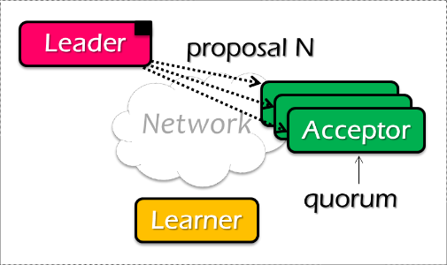
Paxos Pseudo-code
N_{a}: highest proposal number accepted
V_{a}: accepted value of N_{a}
N_{h}: highest proposal number seen
M_{n}: my proposal number
A node decides to be Leader
Leader chooses M_{n} > N_{h}
Leader sends <proposal, M_{n} > to all nodes
Acceptor receives <proposal, N>
if N < N_{h}
reply <promise-reject>
else
N_{h} = N
reply <promise-ok, N_{a}, V_{a}>
Ignore all proposals < N_{h}

Slide 68

Paxos Pseudo-code
N_{a}: highest proposal number accepted
V_{a}: accepted value of N_{a}
N_{h}: highest proposal number seen
M_{n}: my proposal number
If Leader gets promise-ok from a majority
If Leader fails to get majority promise-ok
Upon receiving <accept, N, V>
if V != null, V = the value of the highest N_{a} received
if V = null, then Leader can pick any V
send <accept, M_{n}, V> to all nodes
delay and restart Paxos
if N < N_{h}
reply <accept-reject>
else
N_{a} = N; V_{a} = V; N_{h} = N;
reply <accept-ok>

Slide 69
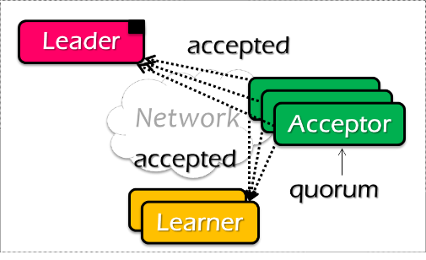
Paxos Pseudo-code
N_{a}: highest proposal number accepted
V_{a}: accepted value of N_{a}
N_{h}: highest proposal number seen
M_{n}: my proposal number
If Leader gets accept-ok from a majority
If Leader fails to get majority accept-ok
send <decide, V_{a}> to all nodes
delay and restart Paxos

Slide 70
Paxos Pseudo-code
N_{a}: highest proposal number accepted
V_{a}: accepted value of N_{a}
N_{h}: highest proposal number seen
M_{n}: my proposal number
N_{a} = V_{a} = null
N_{h} = N0:0
N_{a} = V_{a} = null
N_{h} = N1:0
N_{a} = V_{a} = null
N_{h} = N2:0
M_{n} = N1:1
<proposal, N1:1>
<proposal, N1:1>
N_{h} = N1:1
N_{a} = null
V_{h} = null
N_{h} = N1:1
N_{a} = null
V_{h} = null
<promise, null, null>
<promise, null, null>
<accept, N1:1, V1>
<accept, N1:1, V1>
N_{h} = N1:1
N_{a} = N1:1
V_{h} = V1
N_{h} = N1:1
N_{a} = N1:1
V_{h} = V1
<accept-ok>
<accept-ok>
<decide, V1>
<decide, V1>
Time

Slide 71
Inside of Paxos
N_{a}: highest proposal number accepted
V_{a}: accepted value of N_{a}
N_{h}: highest proposal number seen
M_{n}: my proposal number
Why setups multiple acceptors?
    Failure of the single acceptor halts decision
Why not accepts the first proposal and rejects the rest?
    Multiple leaders result in no majority accepting
    Leader dies
What if more than one leader is active?
    Can both leaders see a majority of promises?
    Then … ?

Slide 72
Inside of Paxos
N_{a}: highest proposal number accepted
V_{a}: accepted value of N_{a}
N_{h}: highest proposal number seen
M_{n}: my proposal number
When is the value V chosen?
    Leader receives a majority <promise, …>
    A majority acceptors receive <accept, N, V>
    Leader receives a majority <accepted, …>
What if acceptor fails after sending promise?
    Must remember N_{h}
What if acceptor fails after receiving accept?
    Must remember N_{h} and N_{a} V_{a}
What if leader fails while sending accept?
    Propose M_{n} again

Slide 73
Question
N_{a}: highest proposal number accepted
V_{a}: accepted value of N_{a}
N_{h}: highest proposal number seen
M_{n}: my proposal number
Suppose that the acceptors are A, B, and C. A and B are also proposers. How does Paxos ensure that the following sequence of events can't happen? What actually happens, and which value is ultimately chosen?
A sends <prepare, 1> requests with proposal number 1, and gets responses from A, B, and C
A sends <accept,1, "foo"> to A and C and gets responses from both. Because a majority accepted, A thinks that "foo" has been chosen. However, A crashes before sending an <accept, 1, "foo"> to B
B sends <prepare, 2> messages with proposal number 2, and gets responses from B and C
B sends <accept, 2, "bar"> messages to B and C and gets responses from both, so B thinks that "bar" has been chosen

Slide 74

Question
N_{a}: highest proposal number accepted
V_{a}: accepted value of N_{a}
N_{h}: highest proposal number seen
M_{n}: my proposal number
A
C
M_{n} = 1
<proposal, 1>
<promise, …>
B
<accept, 1, foo>
M_{n} = 2
<proposal, 2>
<promise, …>
<accept, 2, bar>
Time

Slide 75
Question
N_{a}: highest proposal number accepted
V_{a}: accepted value of N_{a}
N_{h}: highest proposal number seen
M_{n}: my proposal number
A
C
M_{n} = 1
<proposal, 1>
<promise, …>
B
<accept, 1, foo>
M_{n} = 2
<proposal, 2>
<promise, 1, foo>
<accept, 2, foo>
Time

Slide 76
What Could Go Wrong?
Process fails
  Majority does not include it
  When process restarts, it uses log to retrieve a past decision (if any) and past-seen ballot ids. Tries to know of past decisions
Leader fails
  Start another round
Messages dropped
  If too flaky, just start another round
Protocol may never end – tough luck!
  Impossibility result not violated
  If things go well sometime in the future, consensus reached

Slide 77
Paxos Summary
Paxos allows us to ensure consistent (total) ordering over a set of events in a group of nodes
    Events = commands / actions / state updates
Each machine will have the latest state or
a previous version of the state

Slide 78
Paxos Summary
To make a change to the system
    Tell the proposer(leader) the event
    (NOTE: these requests may occur concurrently)
    The leader picks its next highest ID and asks proposal to all the acceptors with that ID
    When the majority of acceptors accept the proposal, accepted event are sent to learners
    The learners do event (e.g., update system state)

Slide 79
Paxos for RSM
Fault-tolerant RSM requires consistent replica view
    View: <primary, backups> (e.g., <node1, node2>)
All active nodes must agree on the sequence of view changes
    <vid-1, primary, backups>, . . .
Use Paxos to agree on the <primary, backups>
    Each Paxos instance agree to a single view
    (e.g., <2, Node1, Node2>)

Slide 80
The CAP Theorem

Slide 81
An Example
Amazon has two zones: US and Euro
  All US users connect to the US zone
  All Euro users connect to the Euro zone
Define Availability and Consistency
  C: all users see the actual number of items
    Not-C: users see 1 item left, but actually is 0
  A: all users can buy items at any time (if there're some)
    Not-A: users might get "cannot buy now, please wait and retry"

Slide 82
The CAP Theorem: 2 out of 3
It is impossible for a distributed computer system to simultaneously provide all three of the following guarantees
  Consistency (all nodes see the same data at the same time)
  Availability (a guarantee that every request receives a response about whether it succeeded or failed)
  Partition tolerance (the system continues to operate despite arbitrary message loss or failure of part of the system)

Slide 83
Partition Tolerance
"P" is usually a reality
  You can never count on the network connectivity
AP: sacrifice C
  If you are selling books, and cannot deliver a book your customer ordered
  Maybe just an apology and a small gift coupon
CP: sacrifice A
  If you are selling airplane ticket but cannot deliver
  Customer may sue you

Slide 84
Not a Binary Decision
Example: a CP system does not mean no "A" at all during network partition
  If the Euro zone and US zone are disconnected, the US zone can still keep available
  Only the Euro zone is not available
  When the network connects again, apply US zone data to Euro zone for consistency

